Slide 1

Basic Operating System Concepts
A Review

Slide 2

Main Goals of OS
Resource Management: Disk, CPU cycles, memory, etc. must be managed efficiently to maximize overall system performance
Resource Abstraction: Software interface to simplify use of hardware resources
Virtualization: Supports resource sharing – gives each process the appearance of an unshared resource

Slide 3
System Call
An entry point to OS code
Allows applications to request OS services
APIs/library functions usually provide an interface to system calls
  e.g, language-level I/O functions may map user parameters into system-call format; in UNIX systems, fork and execve invoke wrapper functions that in turn call the equivalent UNIX system calls.

Slide 4

Some UNIX System Calls
System calls for low level file I/O
  creat(name, permissions)
  open(name, mode)
  close(fd)
  unlink(fd)
  read(fd, buffer, n_to_read)
  write(fd, buffer, n_to_write)
  lseek(fd, offest, whence)
System Calls for process control
  fork()
  wait()
  execl(), execlp(), execv(), execvp()
  exit()
  signal(sig, handler)
  kill(sig, pid)
System Calls for IPC
  pipe(fildes)
  dup(fd)

Slide 5
Execution Modes
(Dual Mode Execution)
User mode vs. kernel (or supervisor) mode
Protection mechanism: critical operations (e.g. direct device access, disabling interrupts) can only be performed when the processor is executing in kernel mode
Mode bit
Privileged instructions

Slide 6
Mode Switching
System calls allow boundary to be crossed
  System call initiates mode switch from user to kernel mode, using a hardware-specific feature.
  Special instruction calls the kernel function, initiating a software interrupt (sometimes called a trap)
  OS executes kernel code (if permitted), mode switch occurs again when control returns to user process

Slide 7
Processing a System Call
Switching between kernel and user mode is time consuming
Kernel must
  Save registers so process can resume execution
  Verify system call name and parameters; verify that the calling program has permission to request the service
  Call the kernel function to perform the service
  On completion, restore registers and return to caller
  Other overhead may be involved; e.g. cache misses

Slide 8

Review Topics
Processes &Threads
Scheduling
Synchronization
Memory Management
File and I/O Management

Slide 9
Review of Processes
Processes
  process image
  states and state transitions
  process switch (context switch)
Threads
Concurrency

Slide 10
Process Definition
A process (task) is an instance of a program in execution.
It encompasses the static concept of program and the dynamic aspect of execution.
As the process runs, its context (state) changes – register contents, memory contents, etc., are modified.

Slide 11
Processes: Process Image
The process image represents the current status of the process
It consists of (among other things)
  Executable code
  Static data area
  Stack & heap area
  Process Control Block (PCB): data structure used to represent execution context, or state
  Other information needed to manage process

Slide 12
Process Execution States
For convenience, we describe a process as being in one of several basic states.
Most basic:
  Running
  Ready
  Blocked (or sleeping)

Slide 13
Process State Transition Diagram
preempt
ready
running
dispatch
event occurs
wait for event
blocked

Slide 14
Other States
New
Exit
Suspended (Swapped)
  Suspended blocked
  Suspended ready

Slide 15
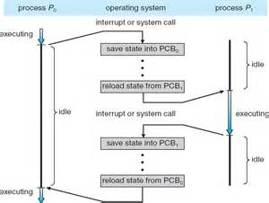
Context Switch
(sometimes called process switch)
A context switch involves two processes:
  One leaves the Run state
  Another enters the Run state
Save status (context) of one
process; restore status of
the second.
Don’t confuse with mode
switch, which may only
affect one process.
Mode switch

Slide 16

Concurrent Processes
Two processes are concurrent if their executions overlap in time.
In a uniprocessor environment, multiprogramming provides concurrency.
In a multiprocessor or multicore computer, true parallel execution can occur.

Slide 17
Forms of Concurrency
Multi programming: Creates logical parallelism by running several processes/threads at a time on a single CPU. The OS keeps several jobs in memory simultaneously. It selects a job from the ready state and starts executing it. When that job needs to wait for some event the CPU is switched to another job. Primary objective: eliminate CPU idle time
Multiprogramming with time sharing: An extension of multiprogramming. After a certain amount of time the CPU is switched to another job regardless of whether the process/thread needs to wait for some operation. Switching between jobs occurs so frequently that the users can interact with each program while it is running. Primary objective: guarantees that all users get a fair fraction of CPU time;
Multiprocessing: Multiple processors on a single computer run multiple processes at the same time. Creates true physical parallelism.

Slide 18
Process Types
Batch processes:
  Input data & program results are file based
  No interaction with users
  Suitable for basic multiprogramming
Interactive/time-shared processes:
  User interacts with process as it runs;
  Program prompts user to enter data or otherwise interact with the code
  Needs an interactive/time-sharing system

Slide 19

Protection
When multiple processes (or threads) exist at the same time, and execute concurrently, the OS must protect them from mutual interference.
Memory protection (memory isolation) prevents one process from accessing the physical address space of another process.
Base/limit registers, virtual memory are techniques to achieve memory protection.

Slide 20
Processes and Threads
Traditional processes could only do one thing at a time – they were single-threaded.
Multithreaded processes can (conceptually) do several things at once – they have multiple threads.
A thread is an “execution context” or “separately schedulable” entity.

Slide 21

Threads
Several threads can share the address space of a single process, along with resources such as files.
Each thread has its own stack, PC, and TCB (thread control block)
  Each thread executes a separate section of the code and has private data
  All threads can access global data of process

Slide 22
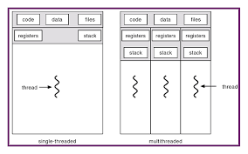


Slide 23
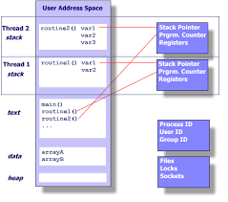

Slide 24
Threads versus Processes
If two processes want to access shared data structures, the OS must be involved.
  Overhead: system calls, mode switches, context switches, extra execution time.
Two threads in a single process can share global data automatically – as easily as two functions in a single process.

Slide 25
Review Topics
Processes &Threads
Scheduling
Synchronization
Memory Management
File and I/O Management

Slide 26
Process (Thread) Scheduling
Process scheduling decides which process to dispatch (to the Run state) next.
In a multiprogrammed system several processes compete for a single processor
Preemptive scheduling: a process can be removed from the Run state before it completes or blocks (timer expires or higher priority process enters Ready state).

Slide 27

Scheduling Algorithms:
FCFS (first-come, first-served): non-preemptive: processes run until they complete or, in multi-programmed systems, until they block themselves for event wait.
RR (round robin): preemptive FCFS, based on time slice
  Time slice = length of time a process can run before being preempted
  Return to Ready state when preempted,
  at the end of the queue.

Slide 28
Scheduling Goals
Optimize turnaround time and/or response time
Optimize throughput
Avoid starvation (be “fair” )
Respect priorities
  Static
  Dynamic

Slide 29
Review Topics
Processes &Threads
Scheduling
Synchronization
Memory Management
File and I/O Management

Slide 30

Interprocess Communication (IPC)
Processes (or threads) that cooperate to solve problems must exchange information.
Two approaches:
  Shared memory
  Message passing (copying
  information from one process address space to another)
Shared memory is more efficient (no copying), but isn’t always possible.

Slide 31
Process/Thread Synchronization
Concurrent processes are asynchronous: the relative order of events within the two processes cannot be predicted in advance.
If processes are related (exchange information in some way) it may be necessary to synchronize their activity at some points.

Slide 32
Instruction Streams
Process A: A1, A2, A3, A4, A5, A6, A7, A8, …, Am
Process B: B1, B2, B3, B4, B5, B6, …, Bn
Sequential
I: A1, A2, A3, A4, A5, …, Am, B1, B2, B3, B4, B5, B6, …, Bn
Interleaved
II: B1, B2, B3, B4, B5, A1, A2, A3, B6, …, Bn, A4, A5, …
III: A1, A2, A3, B1, B2, B3, A4, B4, B5, …, Bn, A5, A6, …, Am

Slide 33
Process Synchronization -
Event ordering – control the interaction of concurrent processes; e.g., insure that event 2 in process A happens before event 4 in process B.
Mutual exclusion - when one process is using a shared resource, no other process should be allowed to access the same resource. This is also referred to as the critical section problem.

Slide 34

Mutual Exclusion
A critical section is the code that accesses shared data or resources.
A solution to the critical section problem must ensure that only one process at a time can execute its critical section (CS).
  “lock” the critical section.
Two separate shared resources can be accessed concurrently.

Slide 35
Data Race
Unknown result due to timing and no CS

Slide 36

Synchronization
Processes and threads are responsible for their own synchronization, but programming languages and operating systems may have features to help.
Virtually all operating systems provide some form of semaphore, which can be used for mutual exclusion and other forms of synchronization such as event ordering.

Slide 37
Semaphores
Definition: A semaphore is an integer variable (S) which can only be accessed in the following ways:
  Initialize (S)
  P(S) // {wait(S)}
  V(S) // {signal(S)}
The operating system must ensure that all operations are indivisible, and that no other access to the semaphore variable is allowed
Atomics are fun!

Slide 38
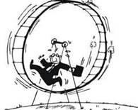
Other Mechanisms for Mutual Exclusion
Spinlocks: a busy-waiting solution
in which a process wishing to enter a critical section continuously tests some lock variable to see if the critical section is available. Implemented with various machine-language instructions
Disable interrupts before entering CS, enable after leaving

Slide 39
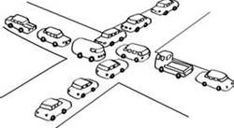
Deadlock
A set of processes is deadlocked when each is in the Blocked state because it is waiting for a resource that is allocated to one of the others.
Deadlocks can only be resolved by agents outside of the deadlock

Slide 40
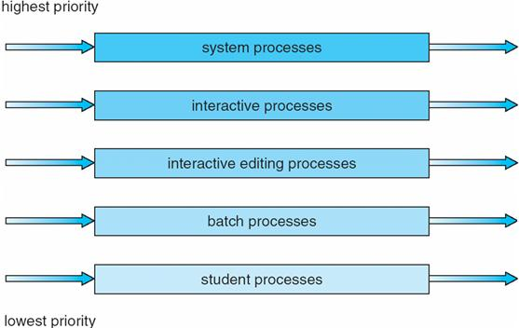
Deadlock versus Starvation
Starvation occurs when a process is repeatedly denied access to a resource even though the resource becomes available. For example:

Slide 41
Deadlock versus Starvation
Deadlocked processes are permanently blocked but starving processes may eventually get the resource being requested.
In starvation, the resource being waited for is continually in use, while in deadlock it is not being used because it is assigned to a blocked process.

Slide 42

Causes of Deadlock
Mutual exclusion (exclusive access)
Hold (current resources) and wait (for another resource)
No preemption
Circular wait

Slide 43
Deadlock Management Strategies
Prevention: design a system in which at least one of the 4 causes can never happen
Avoidance: allocate resources carefully, so there will always be enough to allow all processes to complete (Banker’s Algorithm)
Detection: periodically, determine if a deadlock exists. If there is one, abort one or more processes, or take some other action.

Slide 44
Analysis of Deadlock Management
Most systems do not use any general form of deadlock management because it is not cost effective
  Too time-consuming
  Too restrictive
Exceptions: some transaction systems have roll-back capability; some systems implement ordering techniques to control acquiring of locks.

Slide 45

Review Topics
Processes &Threads
Scheduling
Synchronization
Memory Management
File and I/O Management

Slide 46
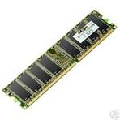
Memory Management
Introduction
Allocation methods – an evolution
  One process at a time
  Multiple processes, contiguous allocation
  Multiple processes, virtual memory

Slide 47
Memory Management - Intro
Primary memory is shared between the OS and user processes.
OS must protect itself from users, and one user process from another.
OS must also manage the sharing of physical memory so that processes are able to execute with reasonable efficiency.

Slide 48
Allocation Methods:
Single Process
Earliest systems used a simple approach: OS had a protected set of memory locations, the remainder of memory belonged to one process at a time.
Process “owned” all computer resources from the time it began until it completed

Slide 49
Allocation Methods:
Multiple Processes, Contiguous Allocation
Several processes resided in memory at one time (multiprogramming/time sharing).
The entire process image for each process was stored in a contiguous set of locations.
Drawbacks:
  Limited number of processes at one time
  Fragmentation of memory

Slide 50
Allocation Methods:
Multiple Processes, Virtual Memory
Motivation for virtual memory:
  to better utilize memory (reduce fragmentation)
  to increase the number of processes that could execute concurrently
Method:
  allow process to be loaded non-contiguously
  allow process to execute even if it is not entirely in memory.

Slide 51
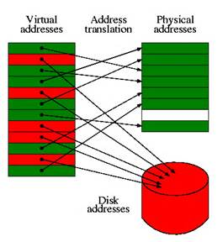
Virtual Memory: Paging
The address space of a program is divided into “pages” – a set of contiguous locations.
Page size is a power of 2; typically at least 4K.
Memory is divided into page frames - same size as a page.
Any “page” in a program can be loaded into any “frame” in memory, so no space is wasted.

Slide 52
Paging - continued
General idea – save space by loading only those pages that a process needs now.
Principle of Locality
Result – more processes (or threads) can be in memory at any given time
Problems:
  How to tell what’s “needed”
  How to keep track of where the pages are
  How to translate virtual addresses to physical

Slide 53
Solutions to Paging Problems
How to tell what’s “needed”
  Demand paging
How to keep track of where the pages are
  The page table
How to translate virtual addresses to physical
  MMU (memory management unit) uses logical addresses and page table data to form actual physical addresses. All done in hardware.

Slide 54
OS Responsibilities in Paged Virtual Memory
Maintain page tables
Manage page replacement

Slide 55

Review Topics
Processes &Threads
Scheduling
Synchronization
Memory Management
File and I/O Management

Slide 56
File Systems
Maintaining a shared file system is a major job for the operating system.
Single user systems require protection against loss, efficient look-up service, etc.
Multiple user systems also need to provide access control.

Slide 57
File Systems – Disk Management
The file system is also responsible for allocating disk space and keeping track of where files are located.
Disk storage management has many of the problems main memory management has, including fragmentation issues.

Slide 58
End of OS Review

